Slide 1
Econ 106: Data Analysis for Economics Lecture 10
slides adapted from: https://jhudatascience.org/tidyversecourse/model.html#descriptive-and-exploratory-analysis

Slide 2
Reminder
Research Milestone #1 is due Sunday 11:59pm
https://pollev.com/vsovero

Slide 3
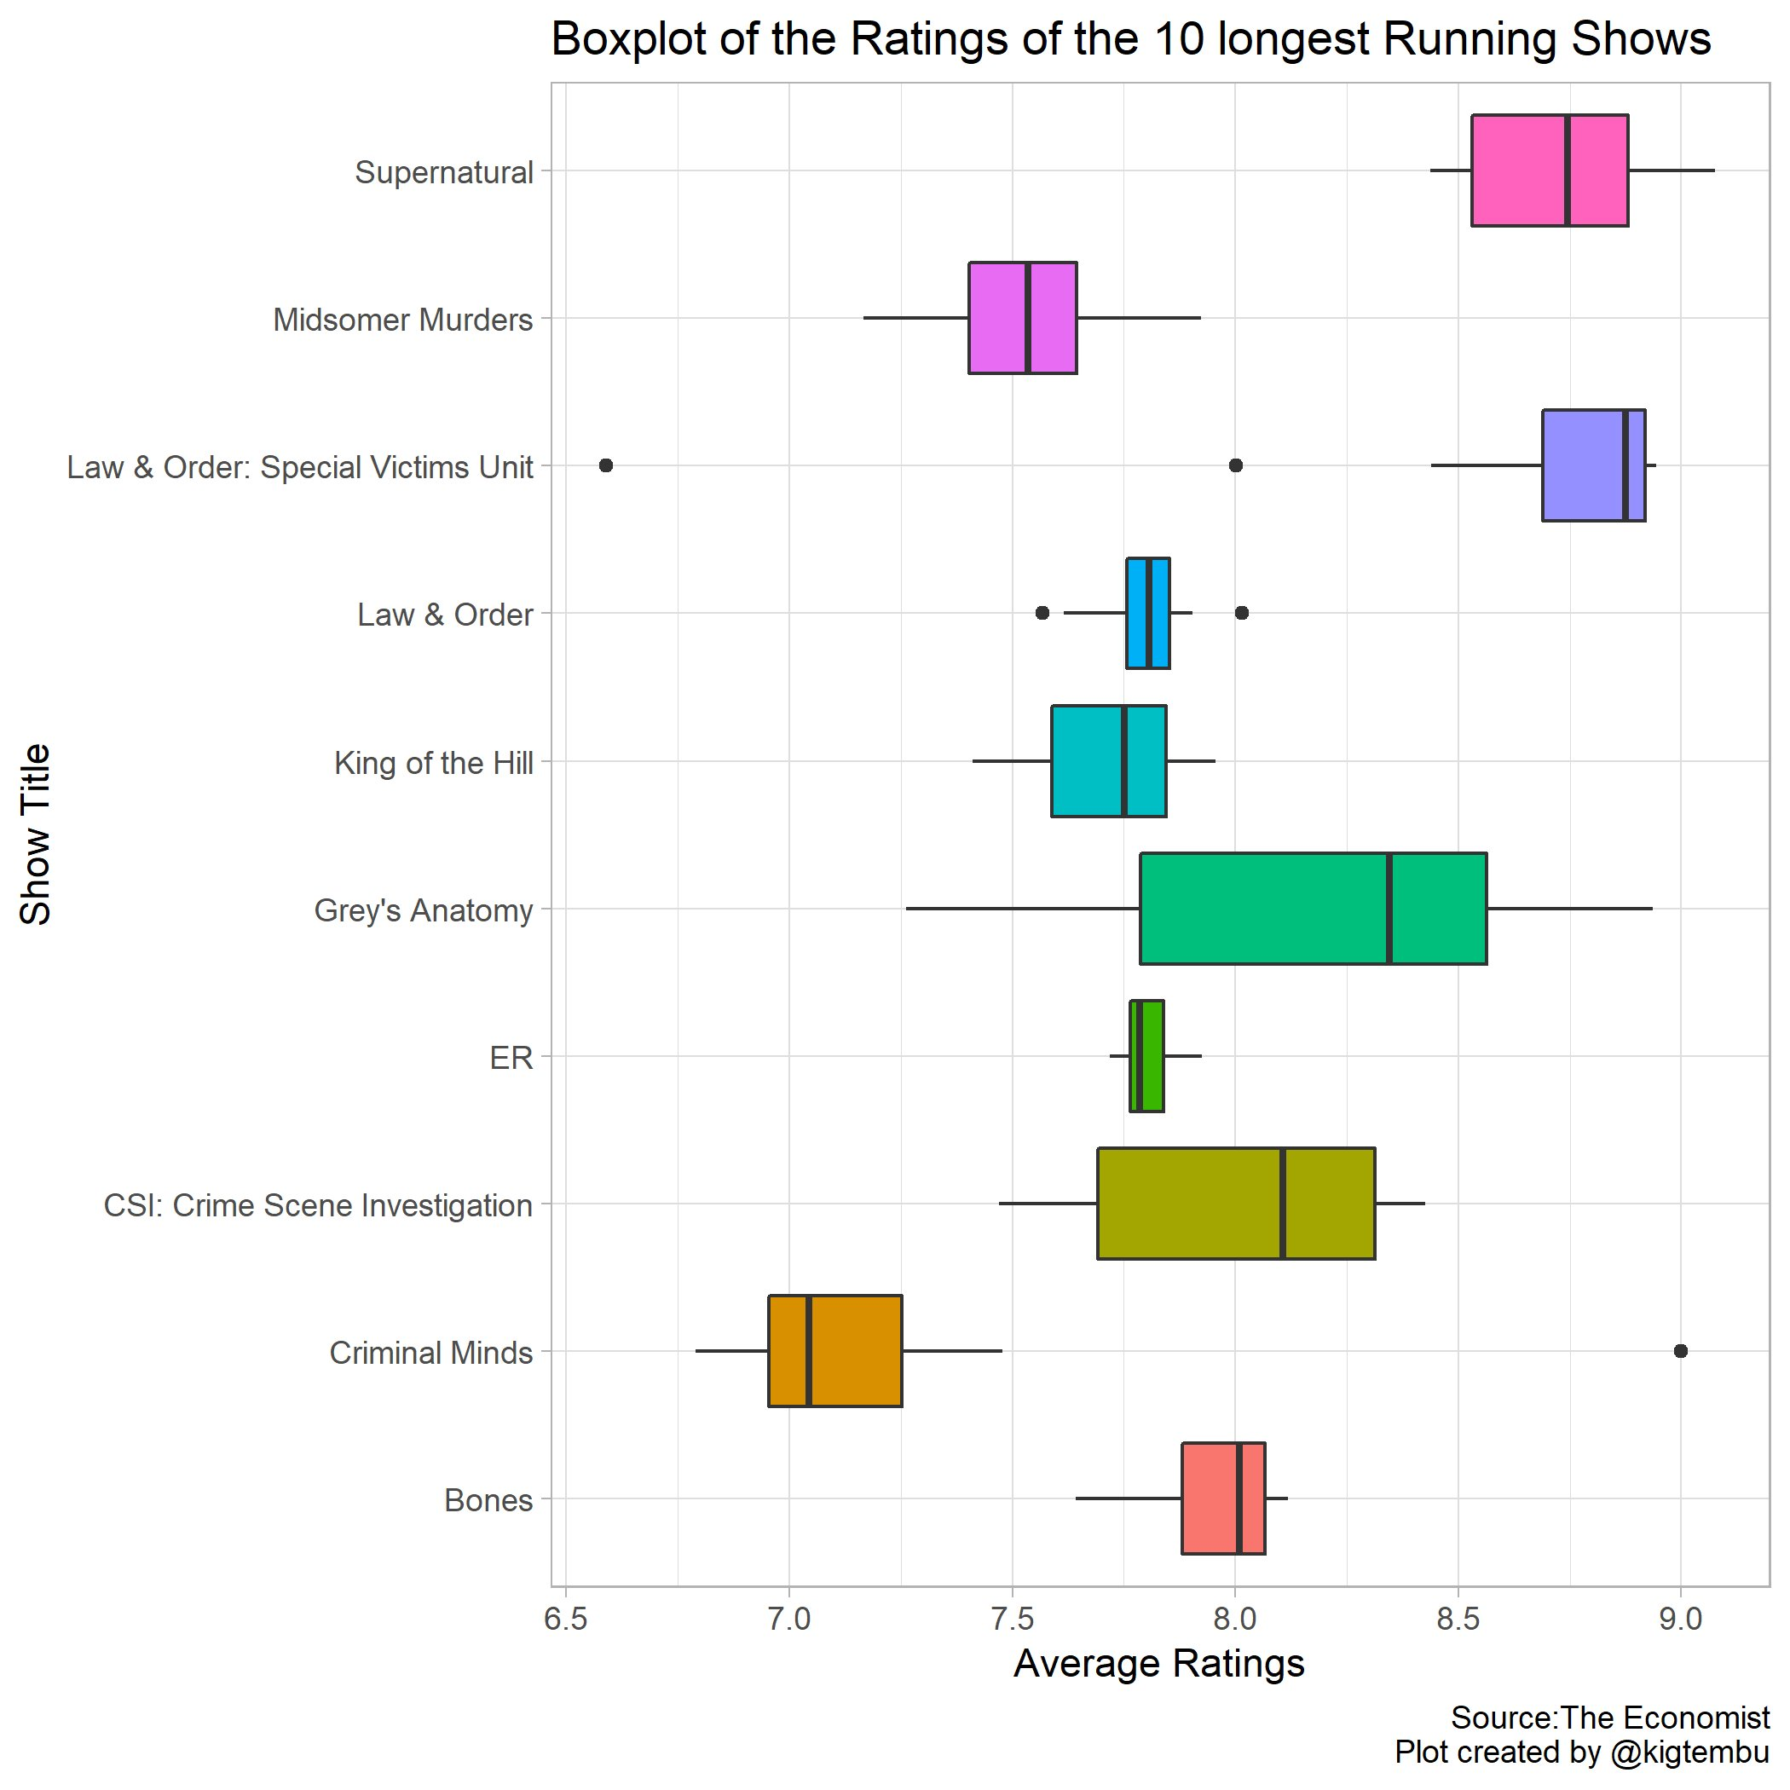
#tidytuesday
Law and Order: SVU is the best (except for two bad seasons)
https://x.com/kigtembu/status/1082355212176814081?s=20

Slide 4
Descriptive and Exploratory Analysis
The goal of a descriptive analysis is to generate simple summaries to describe the data you’re working with
The goal of an exploratory analysis is to explore the data and find relationships that weren’t previously known.

Slide 5
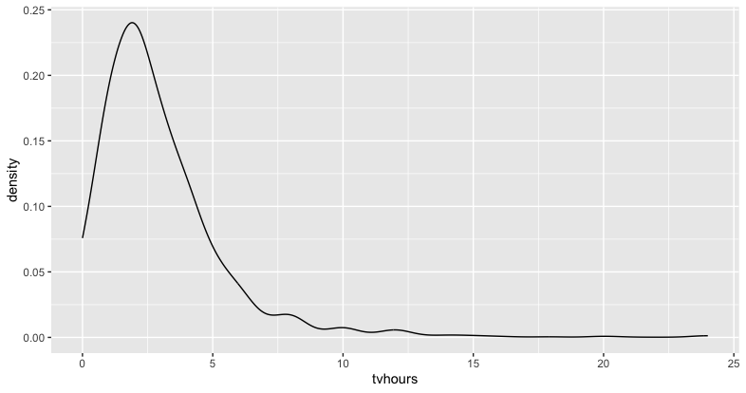
Describing a Quantitative Variable
ggplot(data = gss_cat,
mapping=aes(x=tvhours)) +
geom_density(adjust=2)

Slide 6
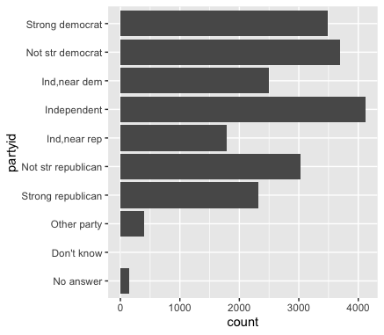
Describing a Categorical Variable
ggplot(data=gss_cat,
mapping= aes(x=partyid))+
geom_bar() +
coord_flip()
We flip the bar chart horizontally when there are a lot of levels or levels with long labels

Slide 7
Filter, then combine levels
Some of the partyid levels have very few cases:
no answer
other party
don’t know)
We’re first going to filter out cases with these answers
Next, we’re going to collapse the remaining levels into:
rep
ind
dem
gss_party<-gss_cat %>%
filter(partyid!="No answer")%>%
filter(partyid!="Don’t know")%>%
filter(partyid!="Other party")%>%
mutate( party_3 = fct_collapse(partyid,
"rep" = c("Strong republican", "Not str republican"),
"ind" = c("Ind,near rep", "Independent", "Ind,near dem"),
"dem" = c("Not str democrat", "Strong democrat")
)

Slide 8
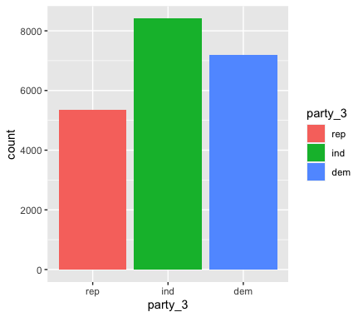
That’s better
ggplot(data=gss_party,
mapping= aes(x=party_3))+
geom_bar(aes(fill=party_3))
I also added color to the bar plot with the fill argument

Slide 9
Exploring Relationships Between Variables
The best way to spot a relationship is to visualize the relationship between two or more variables.
How you do that should depend on the type of variables involved:
categorical and quantitative
categorical and categorical
quantitative and quantitative

Slide 10
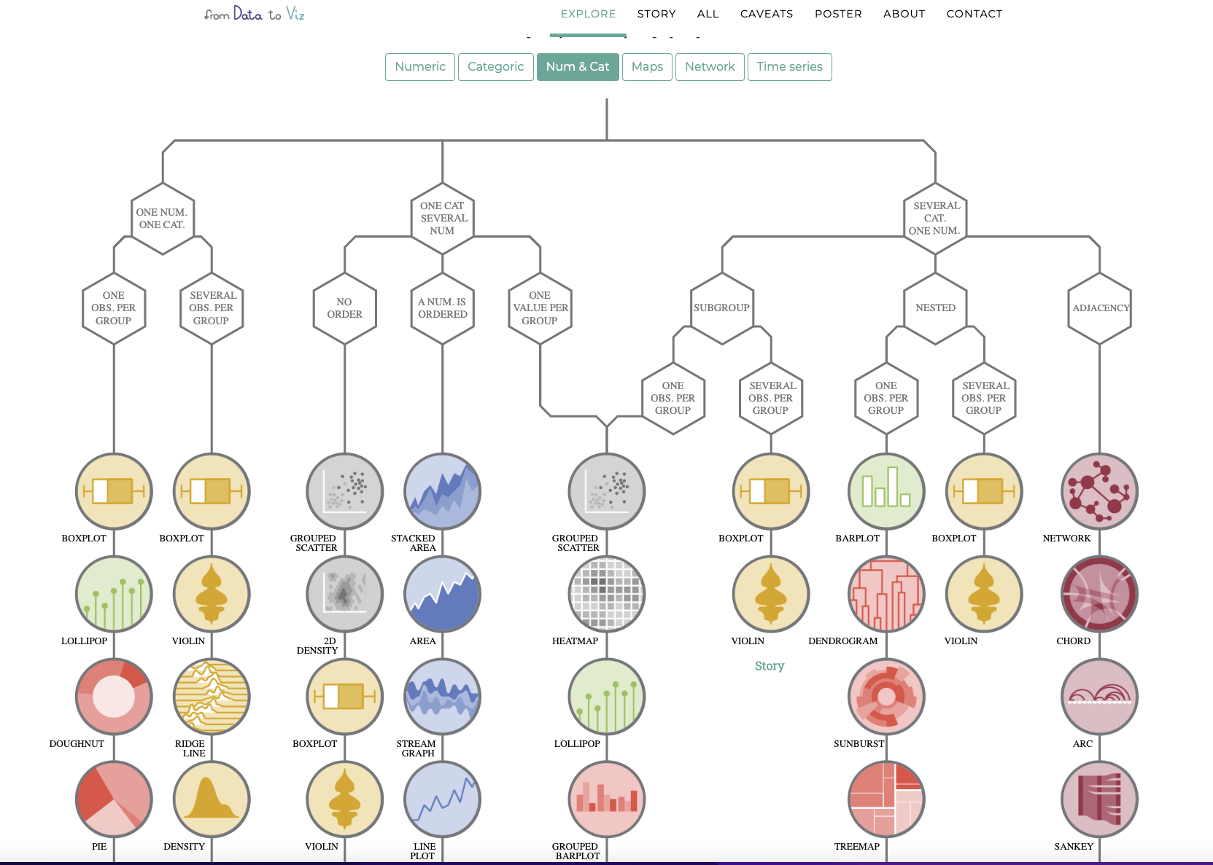
A road map to choosing the right visualization
https://www.data-to-viz.com/

Slide 11
Visualizations for Two Quantitative Variables

Slide 12
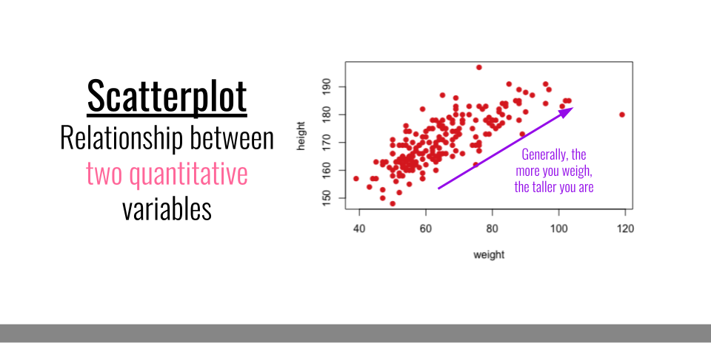

Slide 13
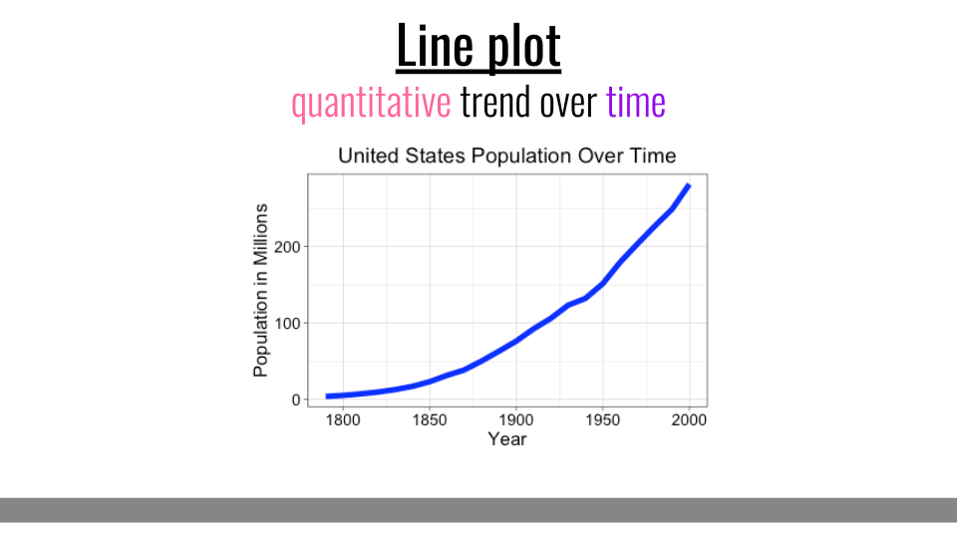
https://pollev.com/vsovero

Slide 14
Visualizations for a Quantitative Variable and a Categorical Variable

Slide 15
GSS TV Hours
Does the distribution of TV hours look different based on political affiliation?
Let’s find out.

Slide 16
Distribution of tvhours by political affiliation
ggplot(data = gss_party,
mapping=aes(x=tvhours)) +
geom_density(adjust=2, aes(color=party_3) )
Color Mapping: color will vary based on the value of party_3
remember to wrap variable names inside the aes() function

Slide 17
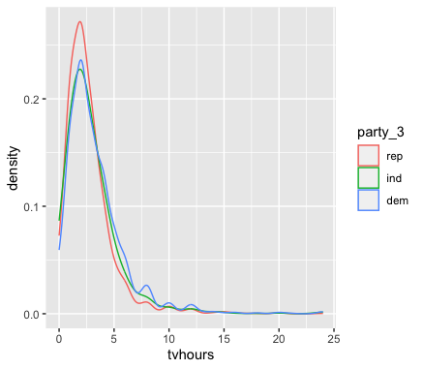
Distribution of tvhours by political affiliation
ggplot(data = gss_party,
mapping=aes(x=tvhours)) +
geom_density(adjust=2, aes(color=party_3) )
This give us a separate density plot of tvhours for each level of party_3
Republicans watch the least amount of tv
Similar tv watching habits between independents and democrats
Democrats watch the most

Slide 18
Class Exercise
Filter out cases where marital is “No answer”
Create a factor variable (marry_fewer) with the following levels:
Married
Previously Married
Never Married
Create a density plot for age by marry_fewer
https://pollev.com/vsovero

Slide 19
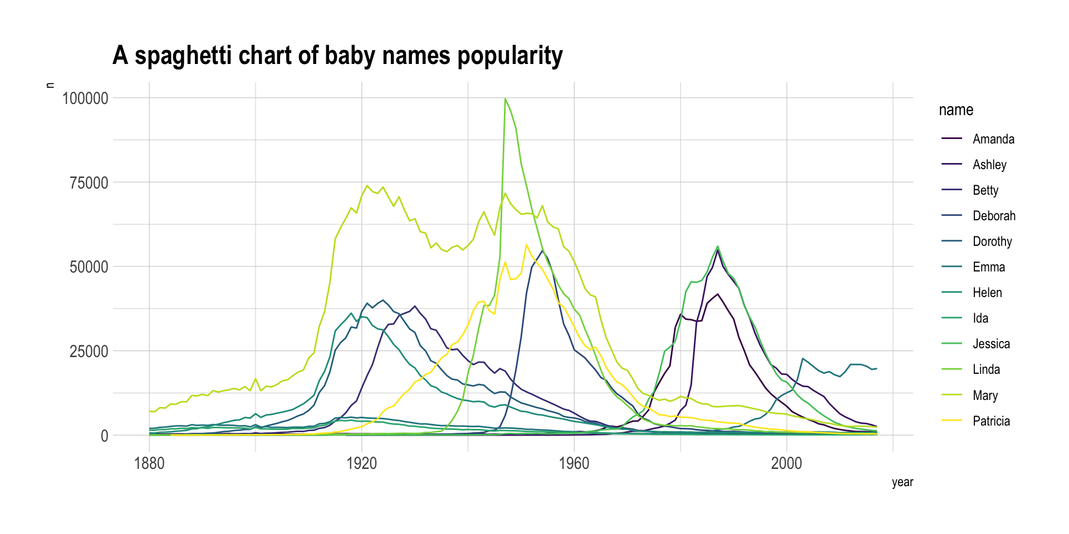
Try Multiple Graphs Instead of a Single Plot
color can help break down the information, but we can still end up with an overcluttered graph
Instead, we can try faceting (break up the information into multiple plots)
https://www.data-to-viz.com/caveat/spaghetti.html

Slide 20
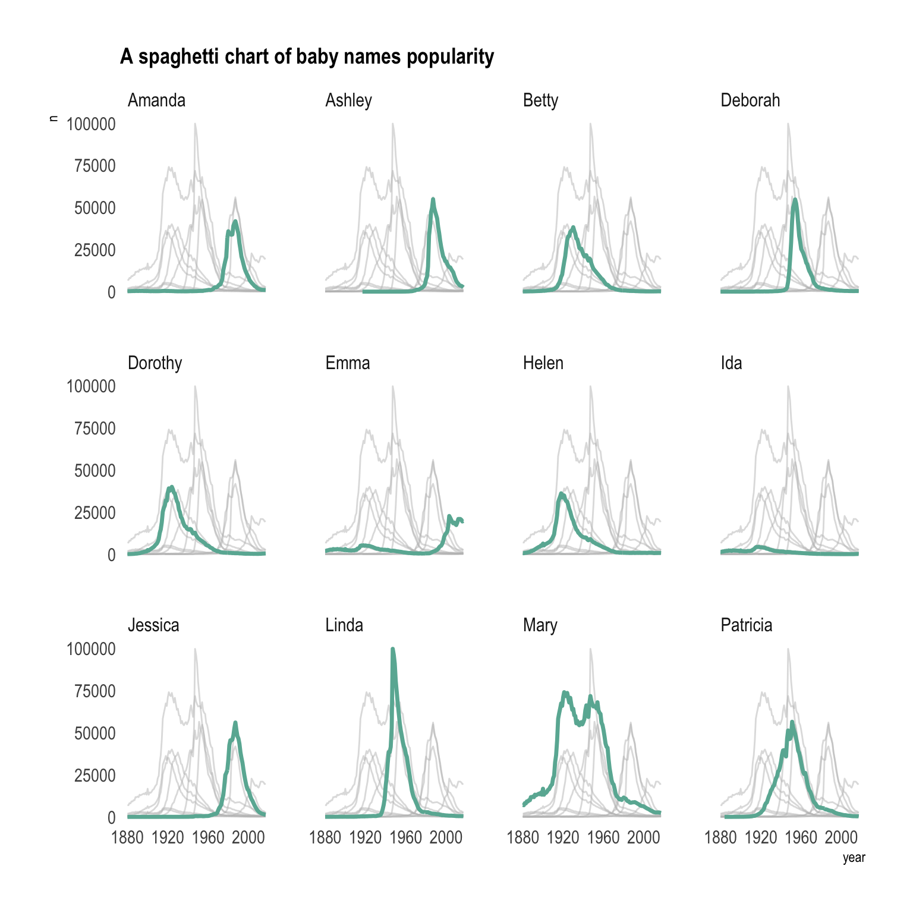
Faceting
https://www.data-to-viz.com/caveat/spaghetti.html

Slide 21
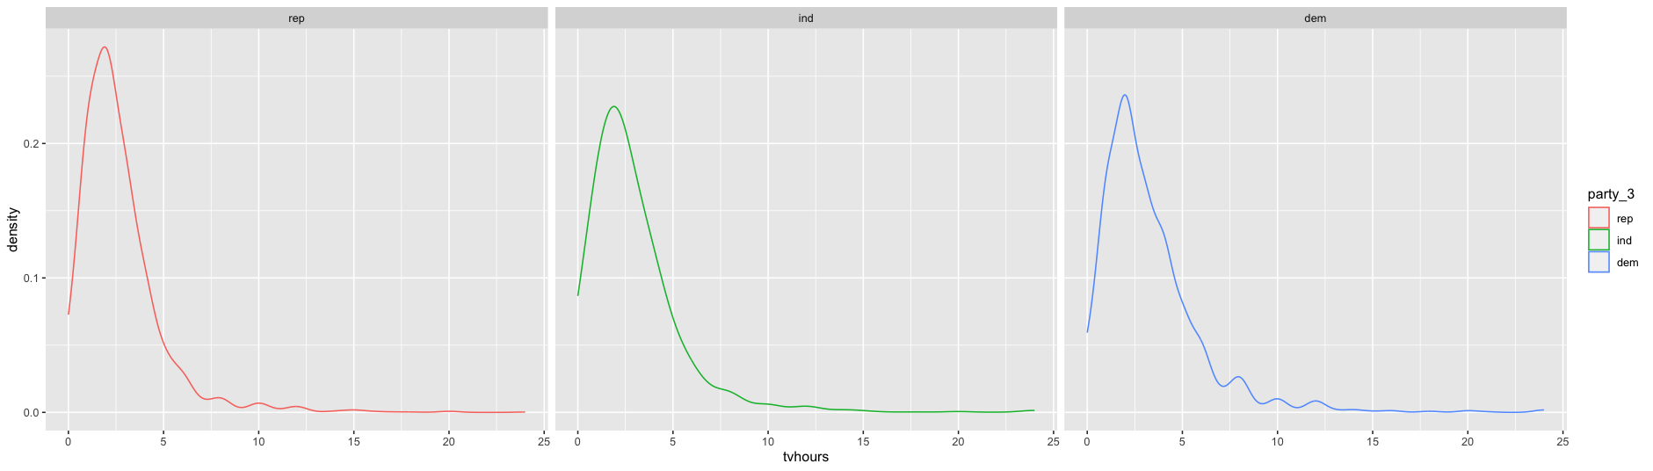
facet_wrap()
gss_party%>%
ggplot(data=gss_party, mapping=aes(x = tvhours)) + geom_density(adjust=2, aes(color=party_3)) + facet_wrap(~ party_3)
Argument: the name of the variable you want to facet on
Output: separate graph for each level of your faceted variable

Slide 22
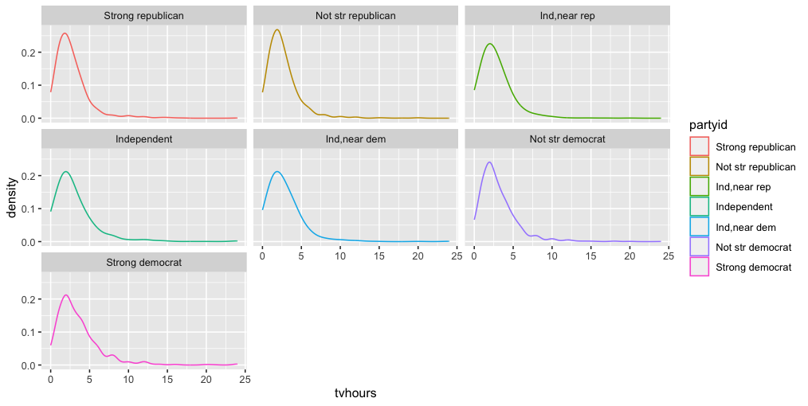
facet_wrap()
ggplot(data = gss_party,
mapping=aes(x = tvhours)) + geom_density(adjust=2, aes(color=partyid)) + facet_wrap(~ partyid)
it’s called facet_wrap() because the plots will wrap to the following row as needed
In this example, partyid has 7 levels, so the graphs will wrap over to the next row

Slide 23
facet_grid()
Do you want everything in a single row? Single column?
facet_grid() gives you this control
ggplot(data = gss_party,
mapping=aes(x = tvhours)) + geom_density(adjust=2, aes(color=party_3)) + facet_grid(.~ party_3)

Slide 24
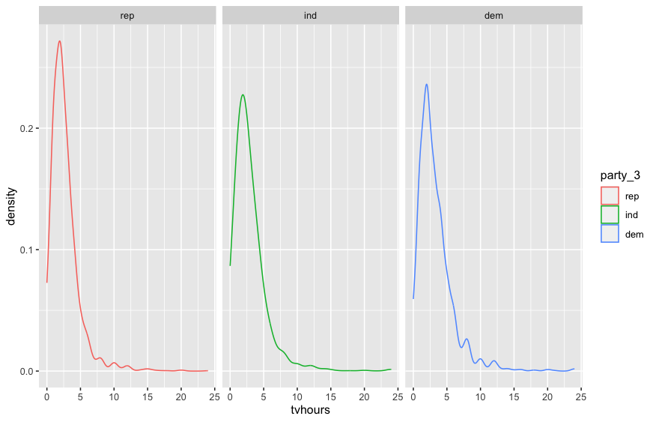
facet_grid()
ggplot(data = gss_party,
mapping=aes(x = tvhours)) + geom_density(adjust=2, aes(color=party_3)) + facet_grid(.~ party_3)
Everything in a single row

Slide 25
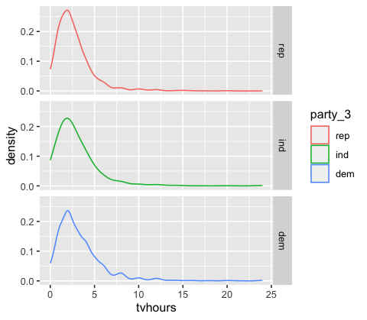
facet_grid()
ggplot(data = gss_party,
mapping=aes(x = tvhours)) + geom_density(adjust=2, aes(color=party_3)) + facet_grid(party_3~.)
Everything in a single column

Slide 26
Class Exercise
Step 1. Create separate density plots for age by marry_fewer (don’t include “No answer”). Put all the plots into a single column.
https://pollev.com/vsovero

Slide 27
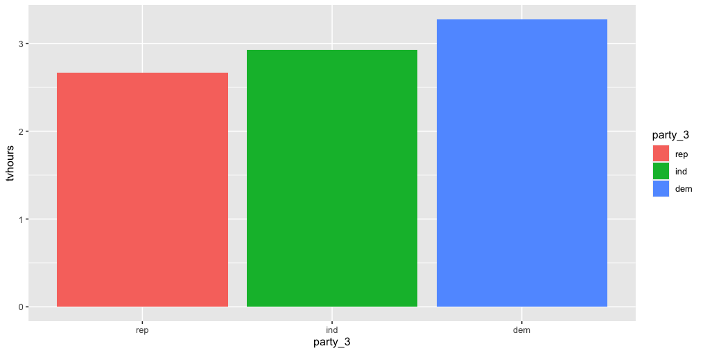
Categorical and Quantitative (Summary Stats)
Instead of showing the entire distribution of tvhours for each level of a categorical variable, we can compare summary statistics
In this example, we are exploring if the average amount of time spent watching tv differs by political affiliation

Slide 28
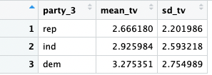
geom_col()
tv_summary<-gss_party%>%
group_by(party_3)%>%
summarize(mean_tv=mean(tvhours, na.rm=TRUE),
sd_tv=sd(tvhours, na.rm=TRUE))
to use geom_col(), you first need to create a summary table of mean tvhours by party_fewer
We will also calculate the standard deviation

Slide 29
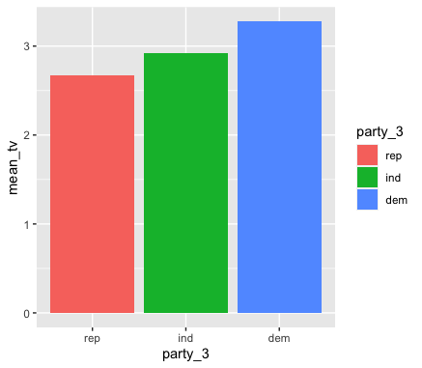
geom_col()
ggplot(data=tv_summary,
mapping=aes(x=party_3, y=mean_tv))+
geom_col(aes(fill=party_3))
when using geom_col(), your y variable is mean_tv from the summary table

Slide 30
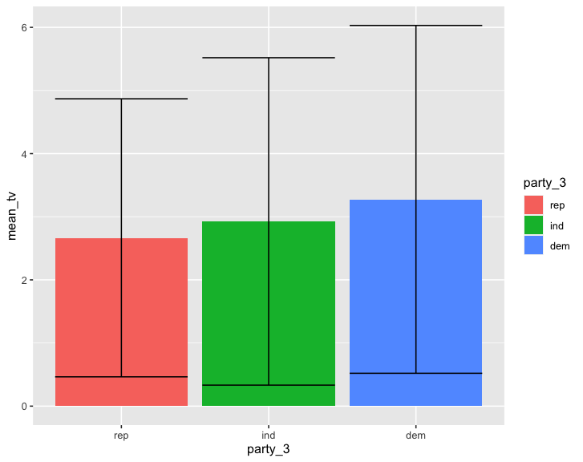
Adding Standard Deviation
ggplot(data=tv_summary,
mapping=aes(x=party_3, y=mean_tv))+
geom_col(aes(fill=party_3)) +
geom_errorbar(aes(ymin=mean_tv-sd_tv, ymax=mean_tv+sd_tv))
We can also add error bars to represent standard deviation
geom_errorbar() arguments:
ymin: the low point of the error bar
ymax: the high point of the error bar

Slide 31
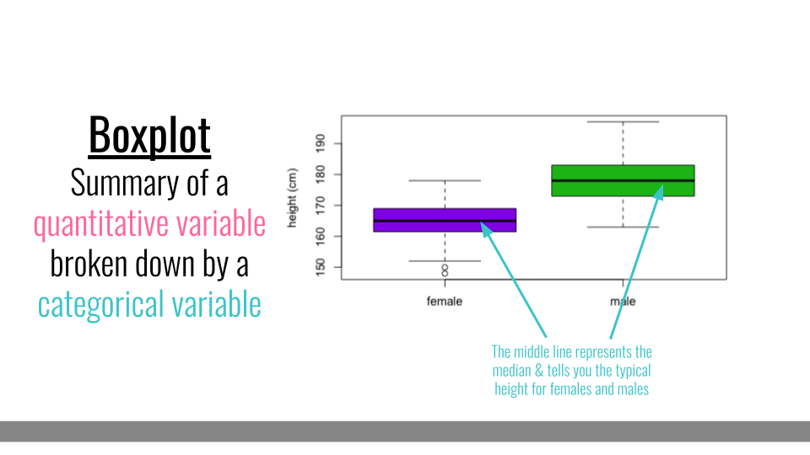
Box plots

Slide 32
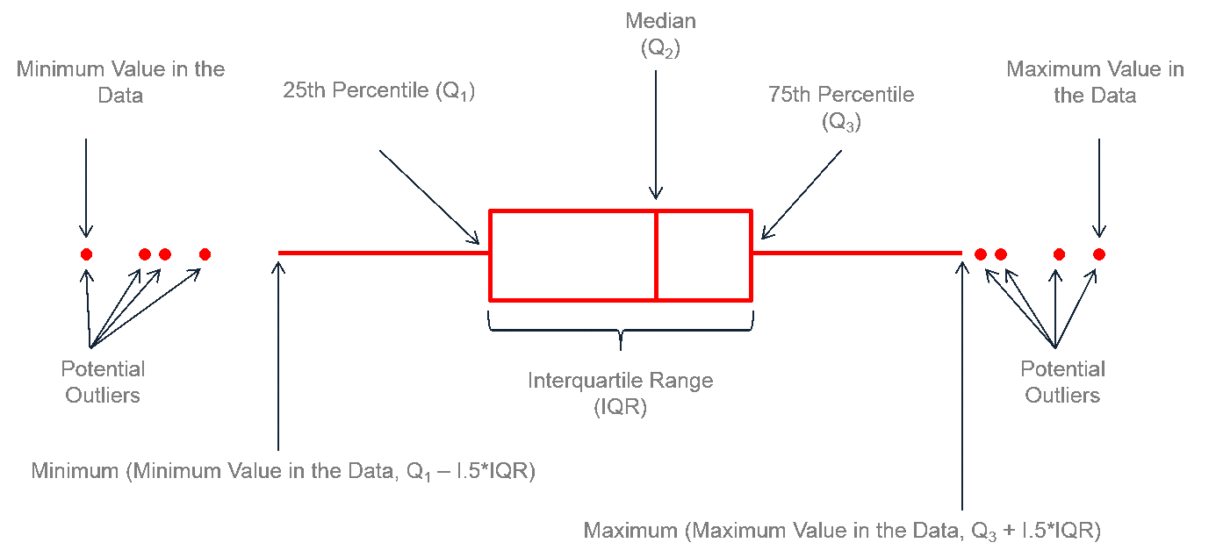
Components of a Box Plot
a box plot gives more information about the distribution of a numeric variable (center and spread)
https://leansigmacorporation.com/box-plot-with-minitab/

Slide 33
Categorical and Quantitative (box plot)
Mapping Arguments:
x= the categorical variable
y= the quantative variable
using fill to color the box plots by party_3
ggplot(data=gss_party,
mapping=aes(x=party_3, y=tvhours))+
geom_boxplot(aes(fill=party_3))

Slide 34
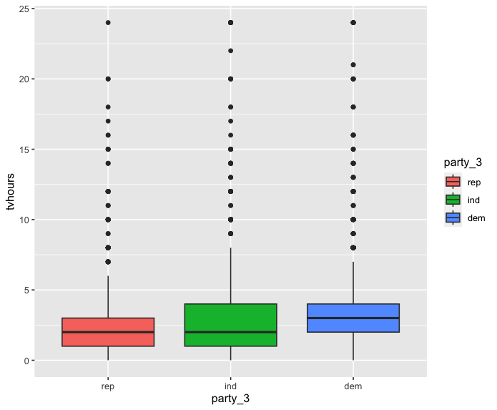
Categorical and Quantitative (box plot)
ggplot(data=gss_party,
mapping=aes(x=party_3, y=tvhours))+
geom_boxplot(aes(fill=party_3))
The box plot is showing that median tv watching is actually similar for republicans and independents
The mean of independents is pulled up by some extreme values (right skewed)

Slide 35
Class Exercise
create a box plot for age by marry_fewer
https://pollev.com/vsovero

Slide 36
Visualizations for Two Categorical Variables

Slide 37
Bar graphs
We use bar plots to display information about categorical variables
We can also examine the relationship between two categorical variables
Example: are there differences in political affiliation by race?

Slide 38
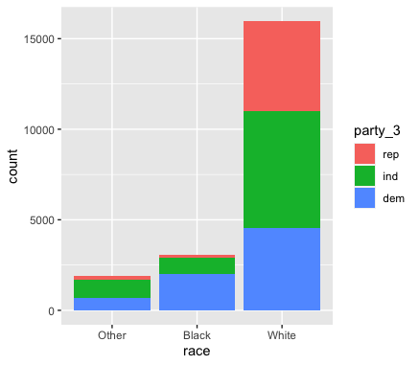
Stacked Barplot
ggplot(data=gss_party,
mapping= aes(x=race)) +
geom_bar(aes(fill=party_3))
Frequencies of political parties within each race

Slide 39
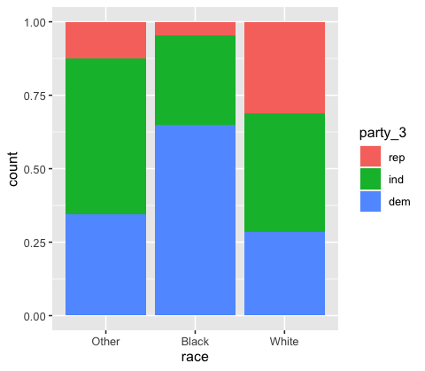
Stacked barplot (proportions)
Proportion of political parties within each race
ggplot(data=gss_party,
mapping= aes(x=race)) +
geom_bar(aes(fill=party_3), position ="fill")

Slide 40
Class Exercise
Create a stacked bar plot that shows the proportions of marital status for each political affiliation

Slide 41
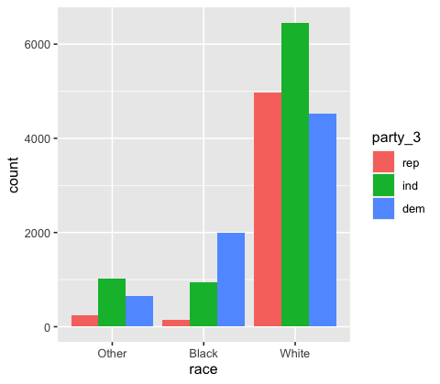
Unstacked barplot
Frequencies of political parties within each race
ggplot(data=gss_party,
mapping= aes(x=race)) +
geom_bar(aes(fill=party_fewer), position ="dodge"))

Slide 42
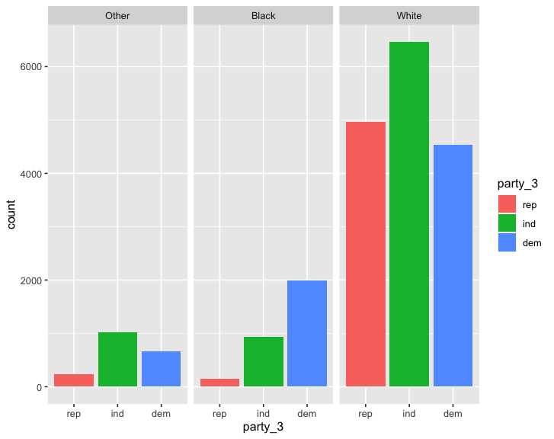
Faceted barplot
ggplot(data=gss_party,
mapping= aes(x=party_3)) +
geom_bar(aes(fill=party_3))+
facet_wrap(~race)

Slide 43
Class Exercise
Create a faceted bar plot that shows the marital status for each political affiliation

